Slide 1




Predicting Maximum Heart Rate:
A Multiple Linear Regression Analysis
Group 1：Amanda Lin Li
Name 2
Name 3

Slide 2
01.
Project Goal & Objectives
CONTENTS
02.
Dataset & Variables
03.
Proposed Methodology
04.
Analysis Workflow
05.
Expected Outcomes & Significance

Slide 3

Project Goal & Objectives
Main Goal:
To build and evaluate a robust multiple linear regression model that identifies and quantifies the key physiological factors predicting a person's maximum heart rate (MaxHR).
Why This Topic is Important:
Understanding the determinants of maximum heart rate is crucial for assessing cardiovascular health and fitness levels.
Max heart rate is a key indicator used in exercise physiology and cardiac risk stratification.
Identifying influencing factors allows healthcare providers to better tailor exercise prescriptions and monitor patients' cardiovascular health.

Slide 4

Dataset & Variables
01
02
03
04
Dataset
Outcome Variables
Predictors
Type of Predictors
UCI Heart Disease Data^{[1]}
Clinical Value: Heart disease is a significant health issue worldwide, and understanding factors that influence heart rate can aid in risk
Relevance to Class: This dataset is excellent to apply multiple linear regression techniques, e.g. handling categorical variables, interaction terms, and model diagnostics.
MaxHR:
Maximum Heart Rate, renamed from thalach
It is a continuous numerical variable.
Age: in years.
Sex: 0 = Female, 1 = Male.
RestBP: Resting Blood Pressure.
Chol: Serum Cholesterol
ExAng: Exercise-Induced Angina (0 = No, 1 = Yes).
Continuous:
Age, RestBP, Chol
Categorical:
Sex, ExAng
[1]: https://www.kaggle.com/datasets/fedesoriano/heart-failure-prediction

Slide 5

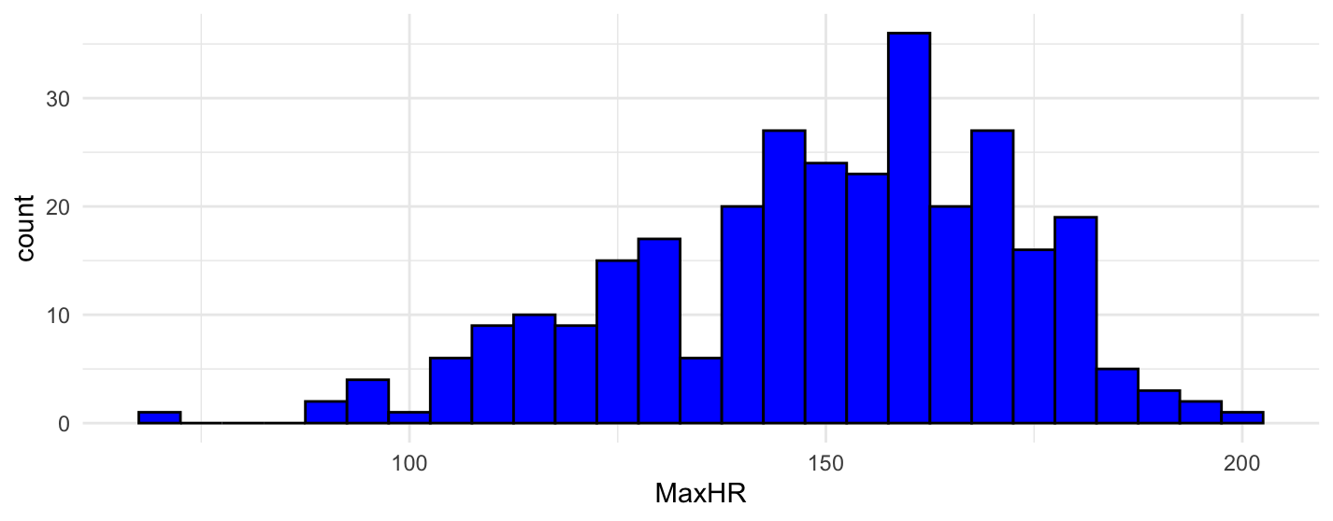
Distribution of Maximum Heart Rate (MaxHR)
Min: 71.0, Median: 153.0, Mean: 149.6, Max: 202.0.
The histogram shows that the distribution of MaxHR is roughly centered between 150 and 170 bpm.

Slide 6
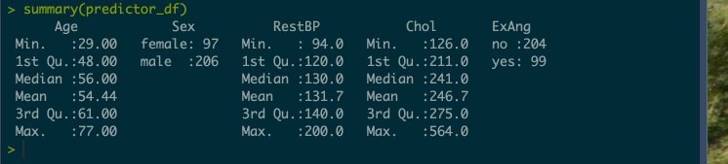
Description of Predictors
Variable | Type | Descriptive Statistics
Age | Continuous | Min: 29.00, Median: 56.00, Max: 77.00
Sex | Categorical | Female: 97, Male: 206
RestBP | Continuous | Min: 94.0, Median: 130.0, Max: 200.0
Chol | Continuous | Min: 126.0, Median: 241.0, Max: 564.0
ExAng | Categorical | No: 204, Yes: 99

